Slide 1
Rainfall sensor Update
Keith Matthews

Slide 2
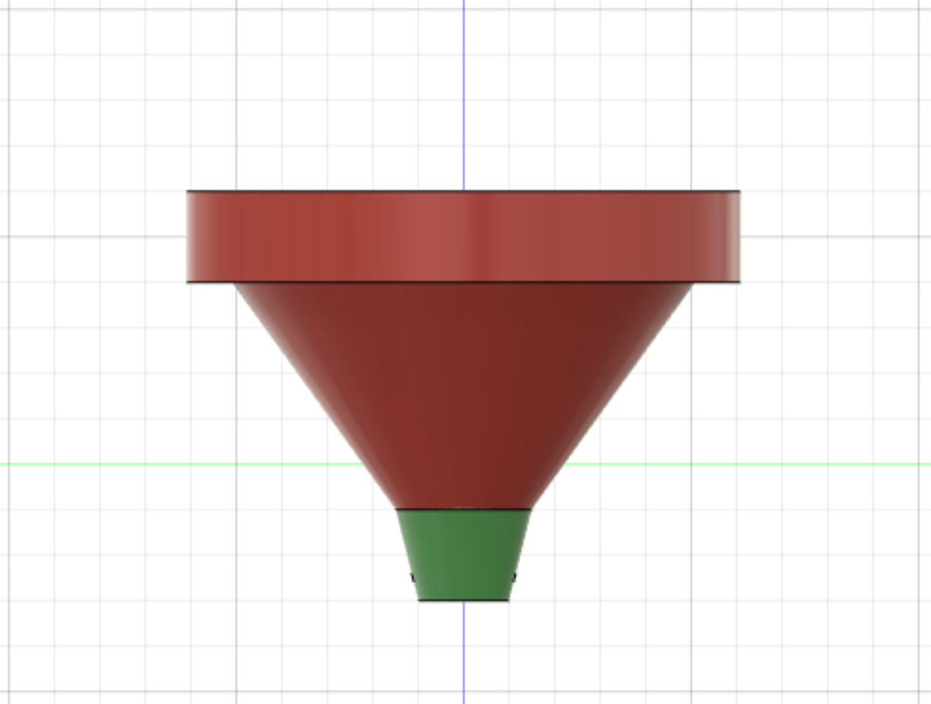
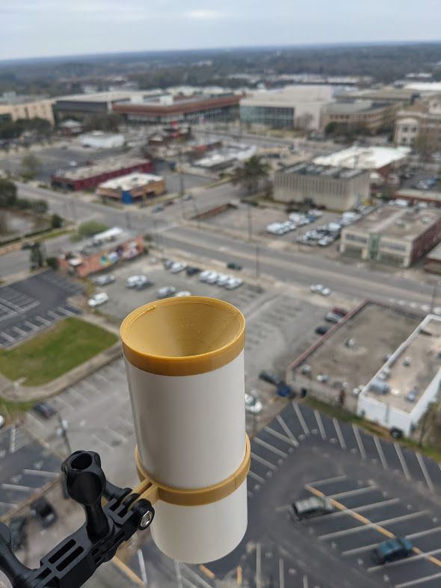
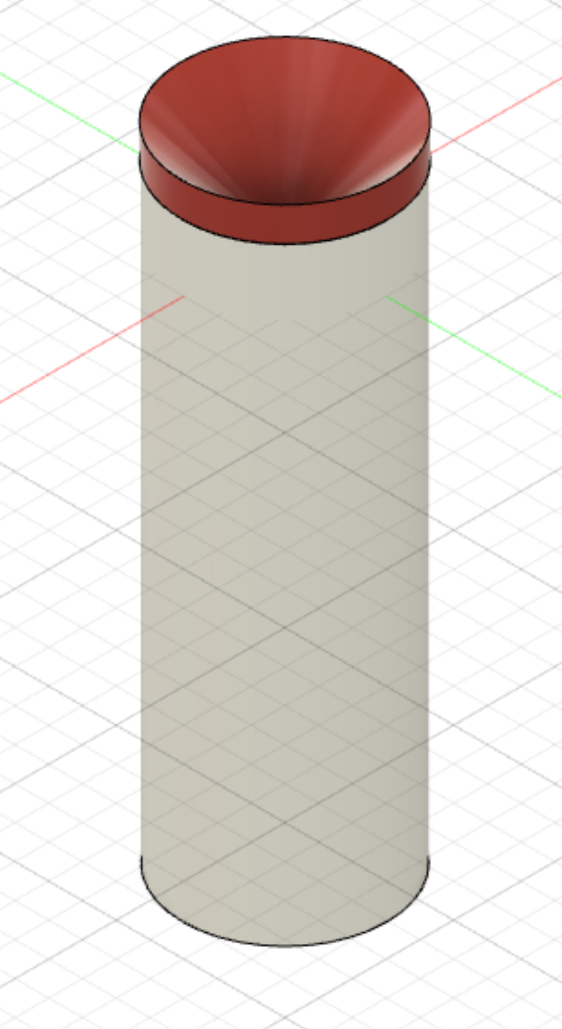
Rainfall sensor
Funnel
Internal Nozzle
No moving parts
High accuracy: drop counting
Counts individual drops per area
Converted to inches/hour
Water drains out the bottom
Electrodes

Slide 3
Thoughts, Question, or Advise?

